Slide 1

Collective dynamics of soft active particles
Edward Jansen
Bas W.A. de Jong
Liza de Wilde

Slide 2
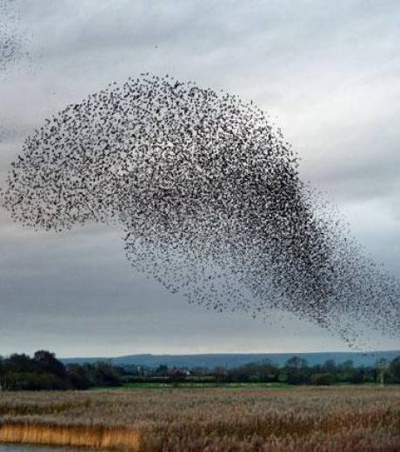
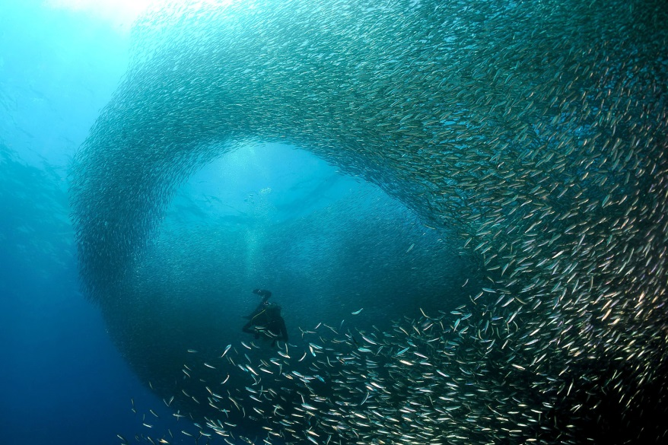
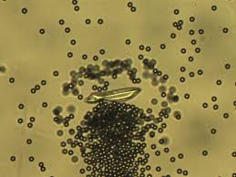
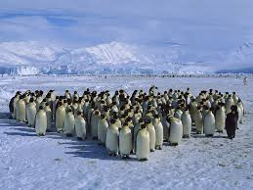
Collective Migration
Notes:
The simple behavior of individuals results in complex, nontrivial dynamics of the group. No individual group member can dictate the collective group behavior or even have anything close to complete information of the group’s dynamics. Nonetheless, the emergent collective patterns have a huge impact on the individuals, and they often depend on them for their very survival. Therefore, it is an obvious question to ask how the rules governing the behavior of each individual relate to the resulting collective behavior of the group.

Slide 3

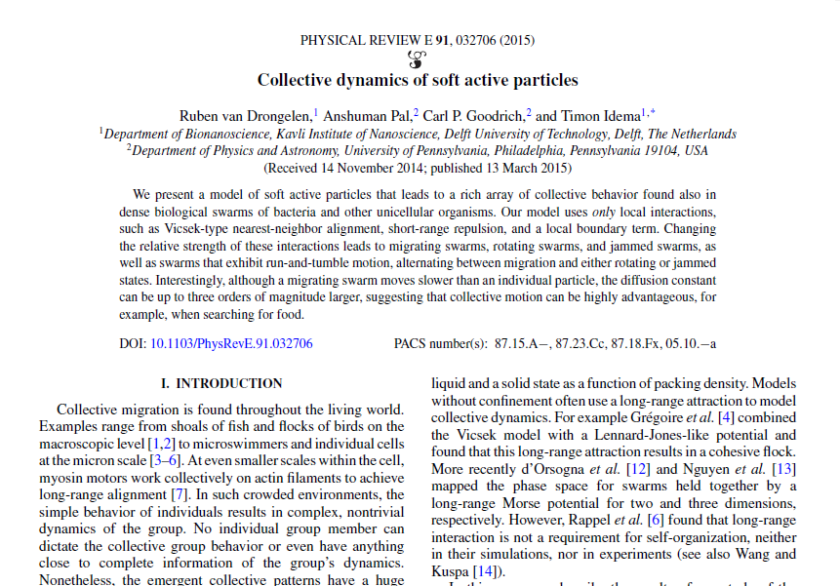
Research

Slide 4
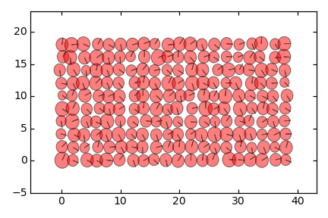
Method
Notes:
Initialize: Radius from Gaussian, on lattice, Small deviation from lattice points to prevent crystallization.

Slide 5
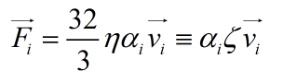
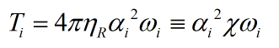
Method
Vanishing Reynolds number → Overdamped motion
Force:
Torque:
Notes:
Individuals in dense, biological swarms often cannot judge the volume of the swarm, but only observe their local environment. Therefore, we consider the local interaction rules we use in this work to be more realistic for describing the rules that individuals in actual swarms follow than models with long-range interactions.

Slide 6
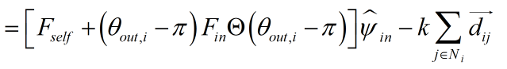
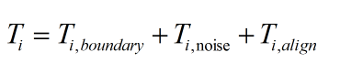
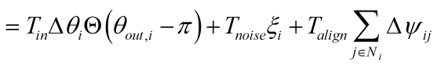
Method
Force:
Torque:
Notes:
Expl eq.
the first two terms of the force are the self-propulsion and the boundary force, which act in the direction of orientation ˆψi . The strength
of these interactions is set by Fself and Fin, respectively. The last force term is the repulsion between overlapping particles i and j , where the amount of overlap is given by | dij | (which, of course, is zero for nonoverlapping particles). The strength of the repulsion force is set by the spring constant k. The first term of the torque in Eq. (4) turns particles on the boundary inwards. The torque is proportional to a parameter Tin times the angle between the orientation ˆψi and the exterior bisector of θout,i . The second term is responsible for the orientational noise a particle experiences.We pick ξi randomly from {−1,1}, each time step creating a torque of magnitude Tnoise. The final term of the torque aligns particles that are neighbors, where the strength is set by Talign, and ψij is the mismatch in orientation between particles i and j . The alignment is the only interaction which acts between particles (apart from the passive repulsion)

Slide 7
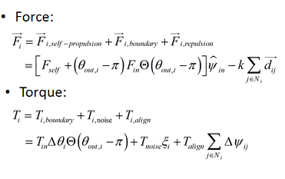
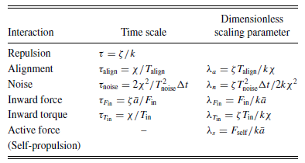
Method
Notes:
Individuals in dense, biological swarms often
cannot judge the volume of the swarm, but only observe their

Slide 8
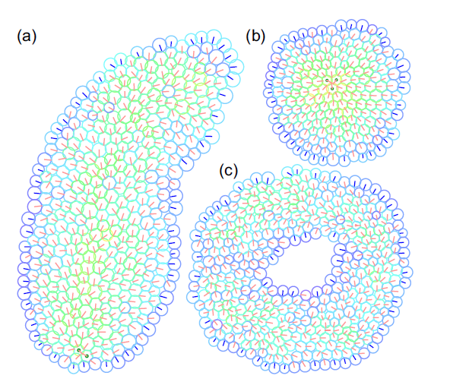
Results
Notes:
Individuals in dense, biological swarms often
cannot judge the volume of the swarm, but only observe their

Slide 9
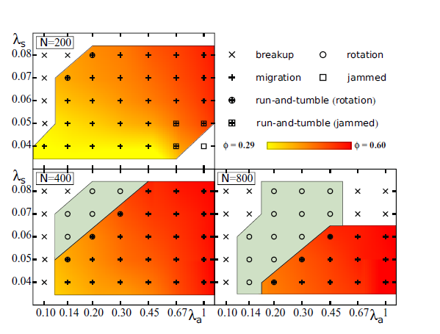
Results
Notes:
Individuals in dense, biological swarms often
cannot judge the volume of the swarm, but only observe their

Slide 10
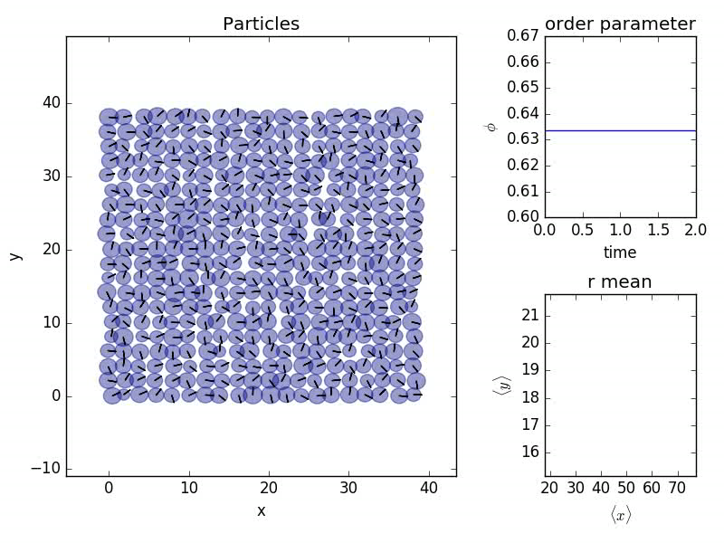
Results: Migrating
Notes:
Individuals in dense, biological swarms often
cannot judge the volume of the swarm, but only observe their

Slide 11
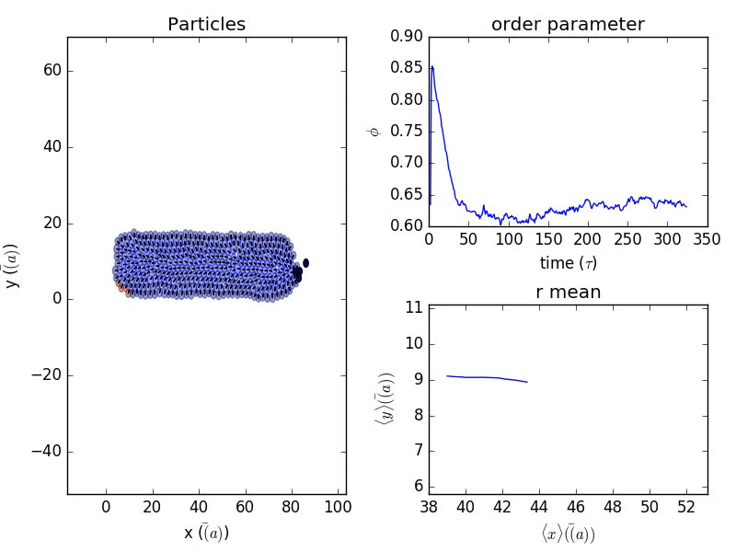
Results: Jammed
Notes:
Individuals in dense, biological swarms often
cannot judge the volume of the swarm, but only observe their

Slide 12
Conclusion
Migrating & jammed configurations → No problem!
Rotating configuration → Need more timesteps!
But.. Computationally very expensive
(cython helps… 50x speed up)

